Slide 1



Energy Consumption Trend Analysis with Power BI

Slide 2

Learning Objectives
Analyzed electricity, gas, and water usage trends across time and location.
Used Power BI visuals to track and compare utility consumption.
Applied Key Influencers to discover factors affecting energy type usage.
Gained insights from both detailed and aggregated data views.
Built interactive dashboards for clear and effective data storytelling.
GOAL
Source :
www.freepik.com/

Slide 3
Tools and Technology used
Microsoft Power BI – For data visualization and interactive dashboards
DAX (Data Analysis Expressions) – For creating custom measures and calculations
Power Query Editor – For data transformation and cleaning
Power BI Visuals – Bar charts, line graphs, pie charts, and tree maps for data analysis
Key Influencers Visual – For AI-driven insights and decision factors
Slicers & Filters – For dynamic report interactivity
Tabular Format View – For detailed data analysis and drill-downs

Slide 4
Methodology
Collected and cleaned energy consumption data using Power Query.
Modeled data and created custom measures with DAX.
Built interactive visuals to track trends across cities, buildings, and time.
Used AI visuals (Key Influencers) to find patterns and influencing factors.
Extracted insights to understand cost and usage behavior.

Slide 5
Problem Statement:
Organizations managing buildings across major cities face difficulty in:
Tracking and comparing electricity, gas, and water consumption.
Understanding how energy usage and cost change over time.
Identifying key factors that influence different types of energy consumption.
Making data-driven decisions due to lack of clear, visual insights.

Slide 6
Solution:
Developed an interactive Power BI dashboard that:
Visualizes energy consumption trends across buildings, cities, and time periods.
Highlights energy usage patterns using graphs, tables, and KPIs.
Uses AI-powered Key Influencers to uncover what impacts energy type usage (e.g., price per unit).
Enables users to drill down into detailed data and make informed decisions to optimize energy use and reduce costs.

Slide 7
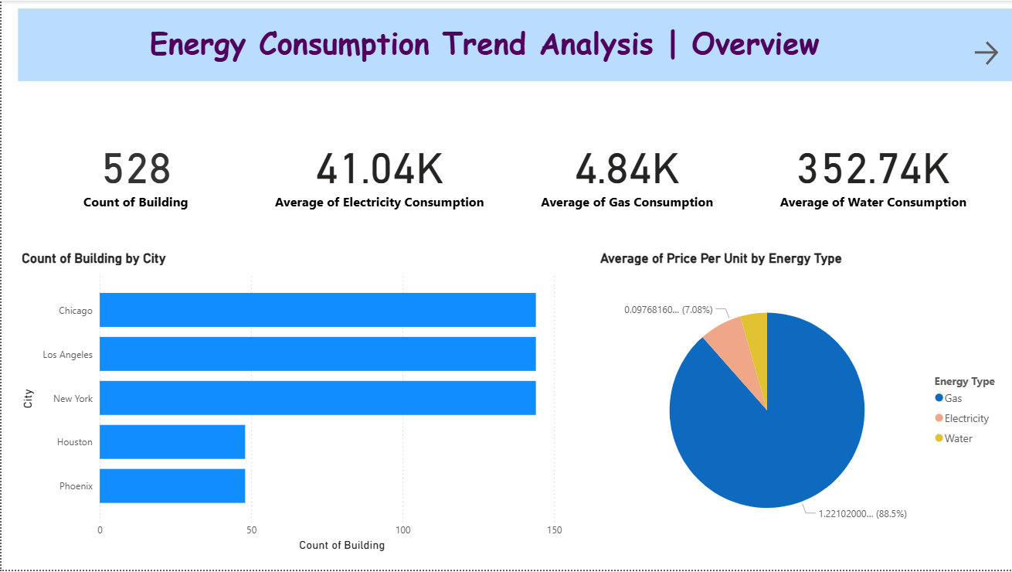
Screenshot of Output:
Purpose: Provides a high-level summary of energy consumption data.
Key Metrics: Total buildings, average consumption, and average price per unit.
Visuals Used:
Card visuals for key metrics
Pie chart showing percentage share of Electricity, Gas, and Water
Bar chart comparing price per unit across energy types
Insight: Water has the highest consumption volume, while gas has the highest price per unit.

Slide 8
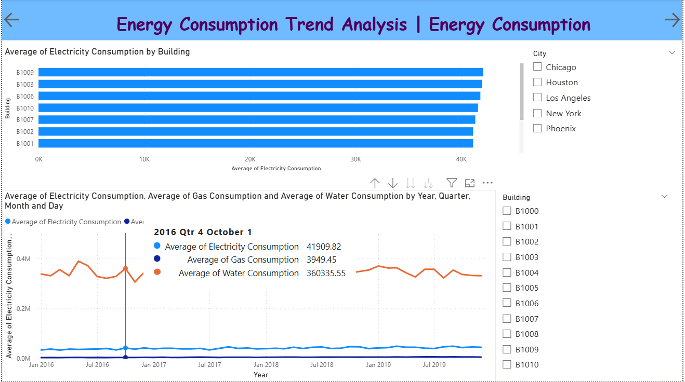
Screenshot of Output:
Purpose: Tracks utility usage trends across years, quarters, and months.
Key Metrics: Total consumption for Electricity, Gas, and Water.
Visuals Used:
Line charts to show monthly and yearly trends
Slicers for dynamic filtering by city, building, year, etc.
Bar chart for total utility usage comparison
Insight: Water shows the highest overall consumption; seasonal variations are minimal across energy types.

Slide 9
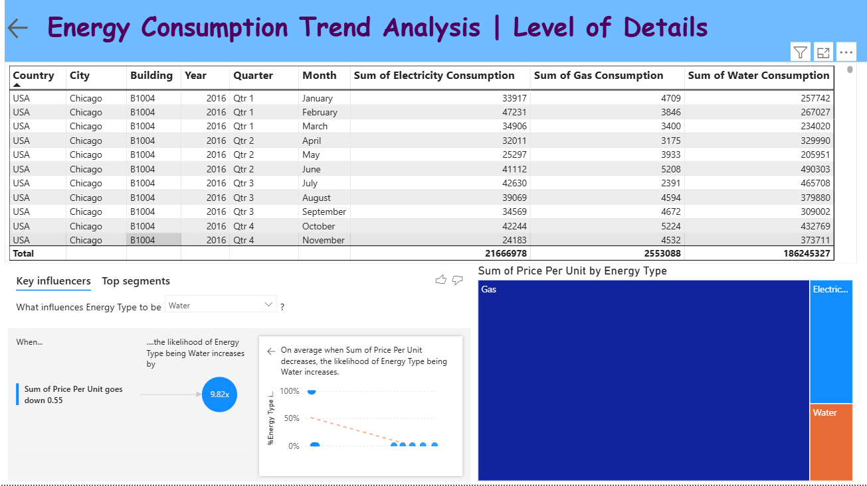
Screenshot of Output:
Purpose: Provides a granular, month-by-month view of energy consumption by building and city.
Key Metrics: Sum of Electricity, Gas, and Water consumption per building and month.
Visuals Used:
Data table showing detailed consumption data
Key Influencers AI visual identifying factors influencing energy type (e.g., price per unit impact on water usage)
Treemap illustrating the distribution of price per unit by energy type
Insight: Water consumption dominates volume, but gas has the highest price per unit; price changes strongly influence energy type classification.

Slide 10
Conclusion:
This project successfully demonstrated how Power BI can be used to analyze and visualize multi-utility energy consumption across buildings and cities over time. By combining detailed data views with interactive visuals and AI-powered insights, it revealed key patterns such as:
Water being the highest consumed resource by volume, while gas has the highest cost per unit.
Energy consumption remains relatively stable with minor seasonal variations.
Price per unit significantly influences the type of energy consumed, especially water usage.
These insights empower organizations to monitor energy usage efficiently, identify cost drivers, and make data-driven decisions to optimize energy management and reduce expenses.

